Slide 1
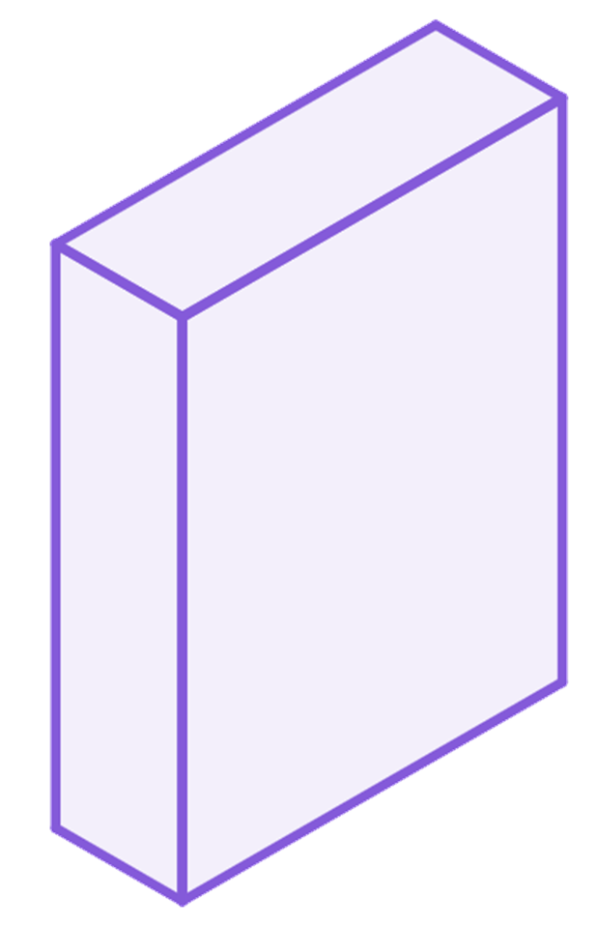
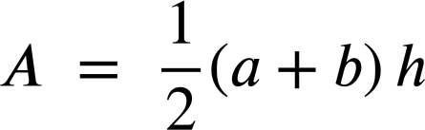
Evaluating expressions without changing the subject
Task A: Rearranging in order to solve
1) The formula for volume of a cuboid can be written as V = lwh
Rearrange the formula to make w the subject. Then evaluate to find the width of a cuboid with length 1.6 cm, height 2.25 cm, and volume 1.44 cm²
h
w
l
2) The formula for the area of a circle is A = πr²
Rearrange the formula to make r the subject. Then evaluate to find the radius of a circle with area 80 cm².
r
Task B: Evaluating without changing the subject
1) Missing dimensions in a trapezium.
b
a) A trapezium has area 95 cm², a lower base length of 23 cm and an upper base length of 15 cm
h
Substitute without rearranging to find the height (h).
a

Slide 2

Evaluating expressions without changing the subject
b) A trapezium has area 88 cm², a lower base length of 14 cm and a height of 8 cm
b
h
Substitute without rearranging to find the upper base (b).
a
c) Compare the approaches in parts a) and b)
2) A right triangle has hypotenuse 13 cm, and one shorter length of 12 cm
a) Substitute and evaluate without rearranging to find the remaining shorter length.
c
a
b
b) Rearrange to make a the subject, then substitute to find the remaining shorter length.
c) Compare the approaches in parts a) and b)
Mathematics in Education and Industry
v2.3

